Slide 1
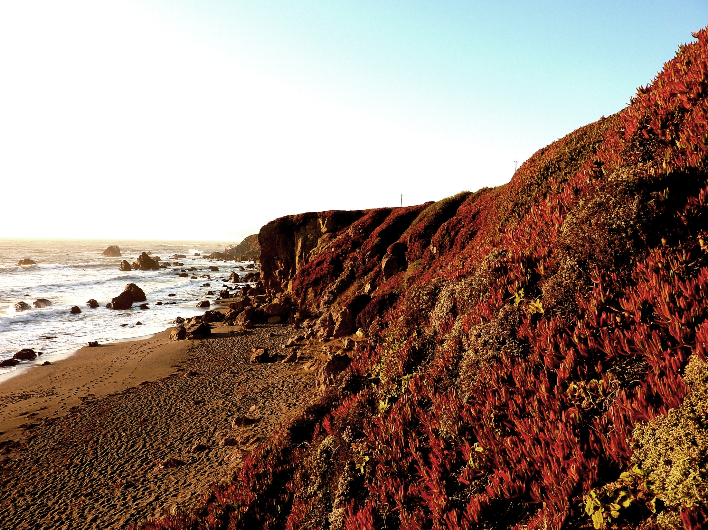
GOING
NOWHERE

Slide 2
GOING NOWHERE
Your Word is a lamp unto my feet
Your Word is a Light to guide my way.
All around me the World is darkness,
Temptations luring, appear like brightness.
Oh Lord, keep me on your way.

Slide 3
Your Word is a lamp unto my feet.
Your wisdom guides my every day.
Send me your Spirit, let me not wander,
Let me not fall down, Oh make me stronger
Oh, Lord, help me on my way.

Slide 4
Jesus, Light of the World,
shine out into my darkness.
Your light leads me to life.
I’m going nowhere without you.
I’m going nowhere,
I’m going nowhere,
I’m going nowhere without you.

Slide 5
Your Word is a lamp unto my feet.
Your Word is the light to guide my day.
Even when your light is brightest
I lose my way, fall into darkness.
Take my hand and lead me on my way.

Slide 6
Jesus, Light of the World,
shine out into my darkness.
Your light leads me to life.
I’m going nowhere without you.

Slide 7
Jesus, Light of the World,
shine out into my darkness.
Your light leads me to life.
I’m going nowhere without you.

Slide 8
Jesus, Light of the World,
shine out into my darkness.
Your light leads me to life.
I’m going nowhere without you.

Slide 9
I’m going nowhere,
I’m going nowhere,
I’m going nowhere without you.

